Slide 1

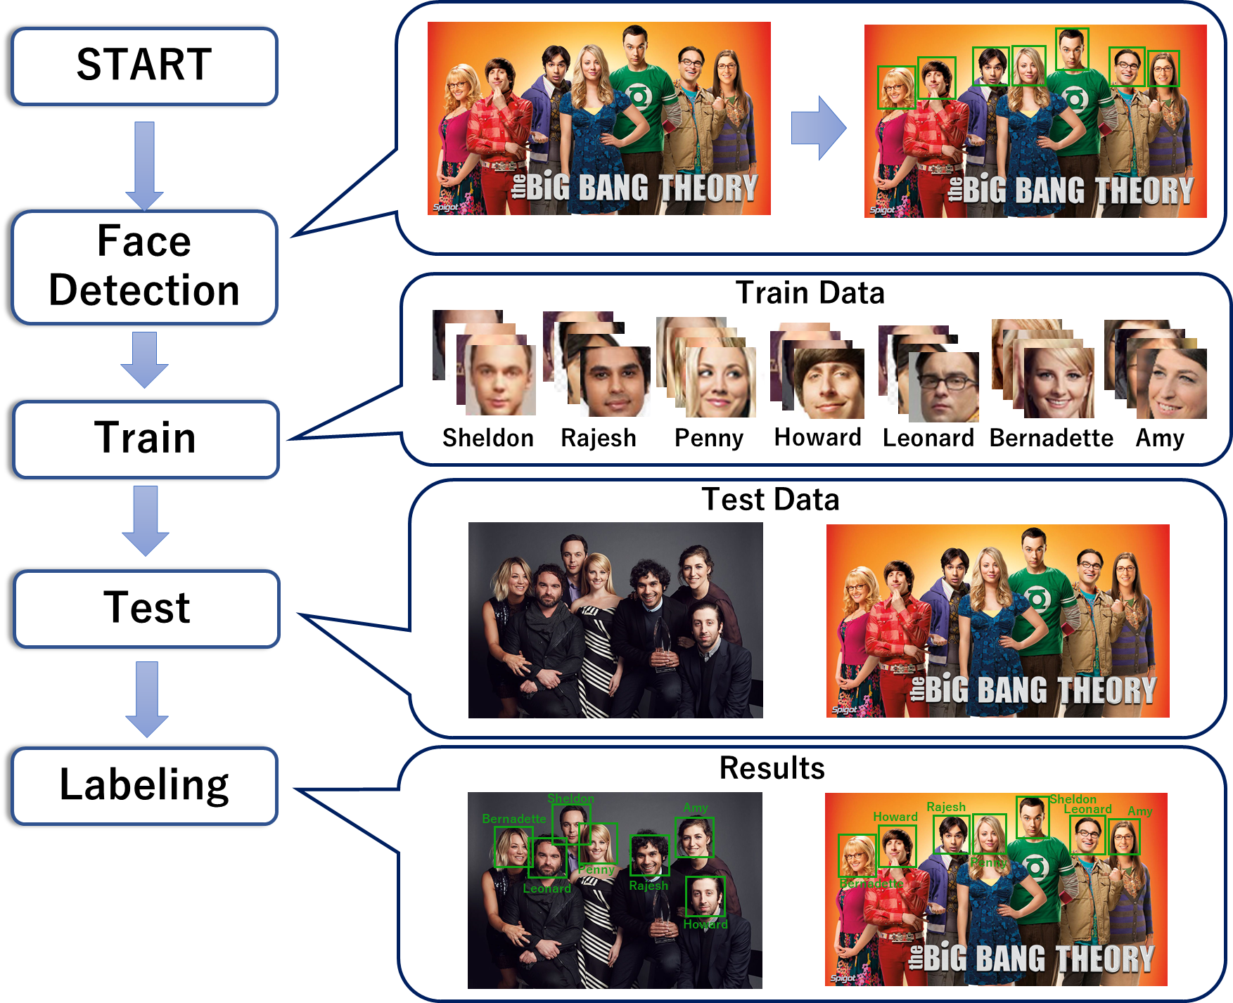
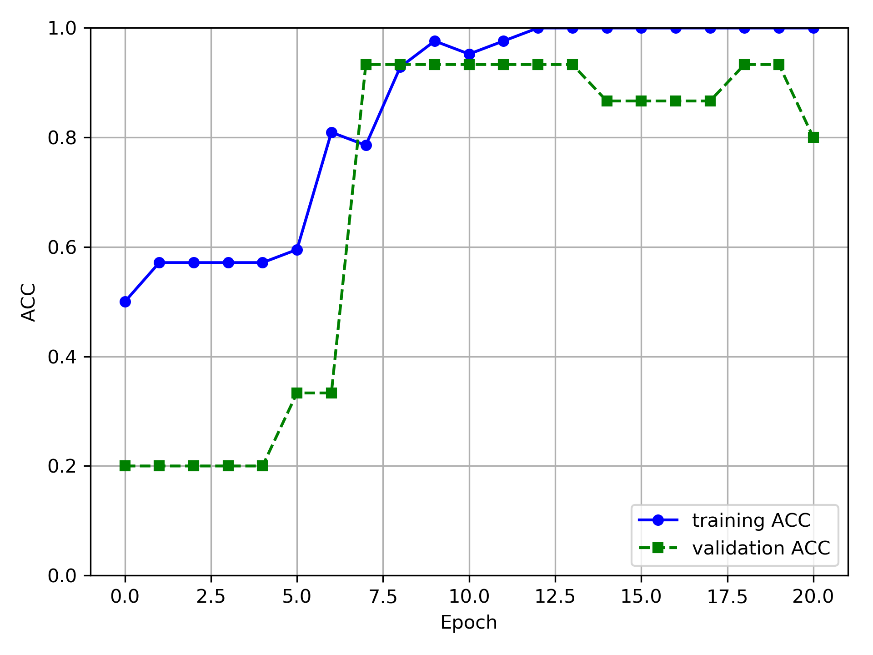
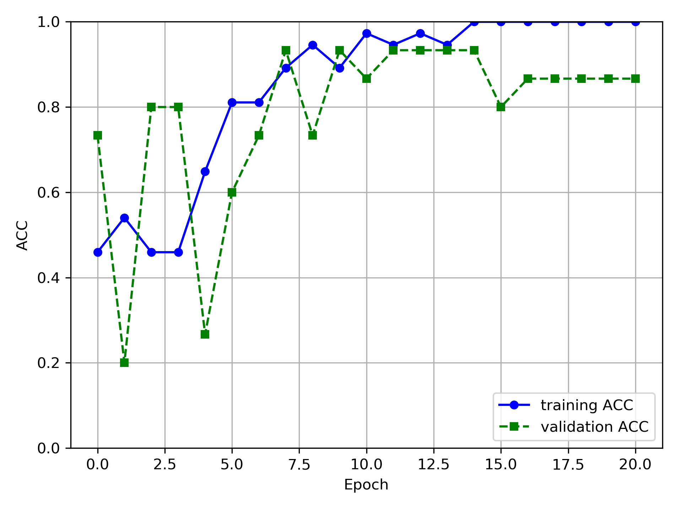
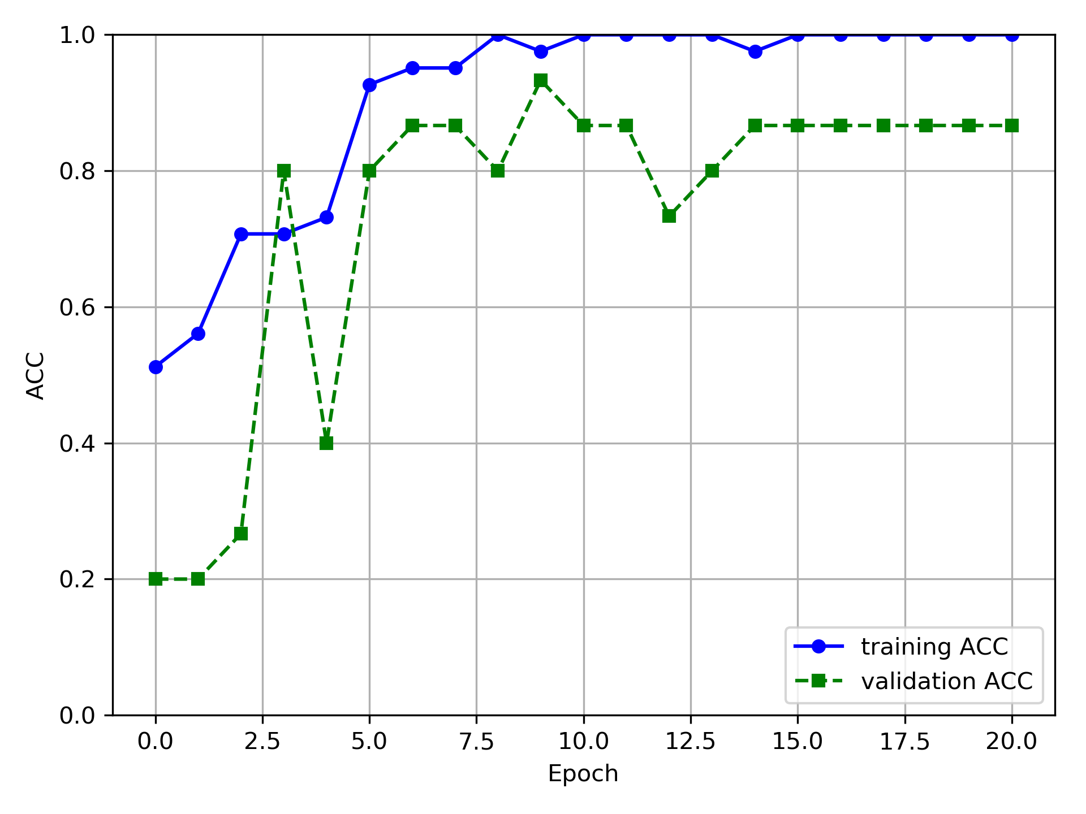
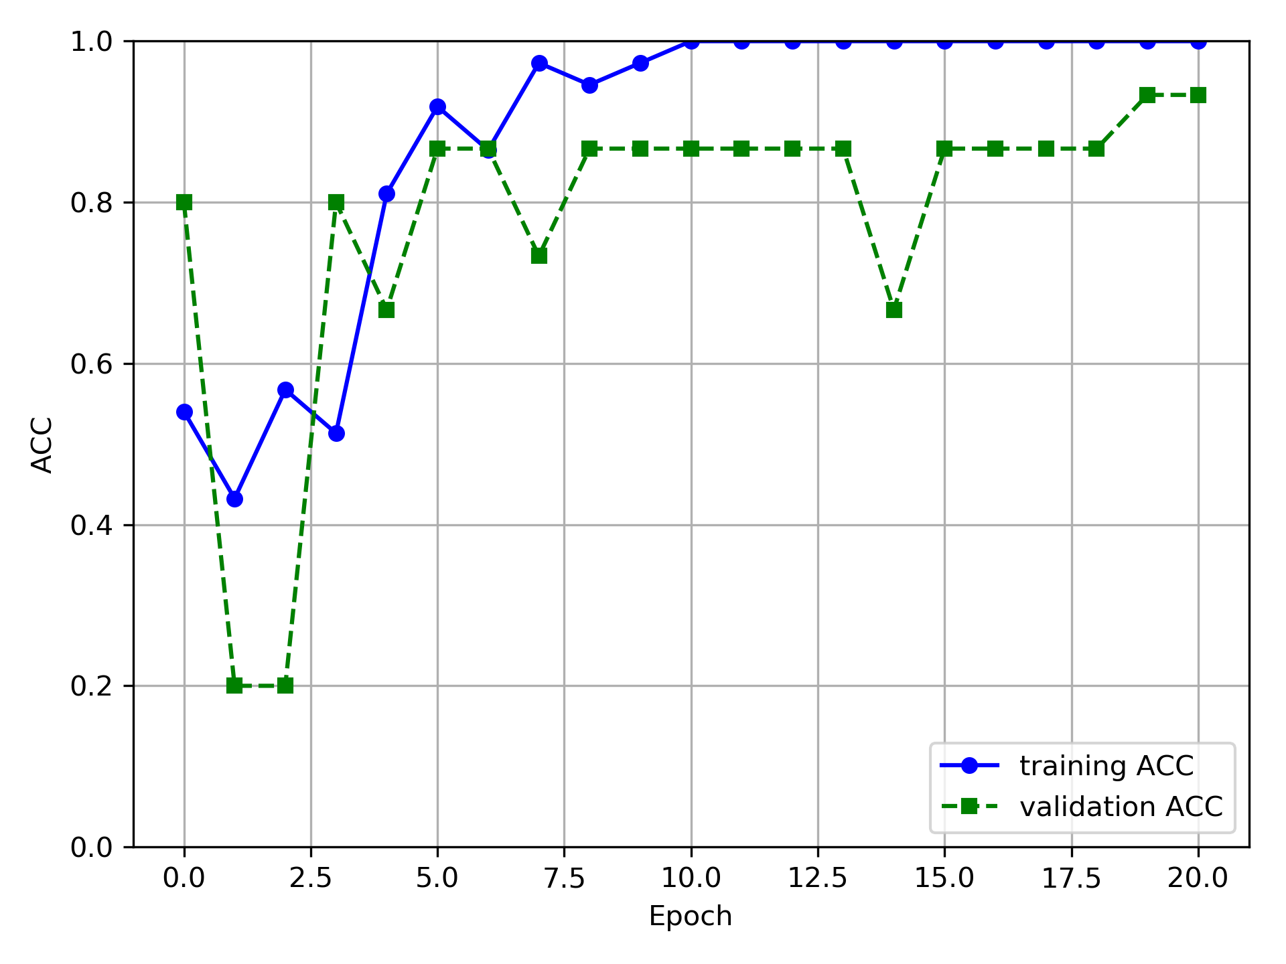
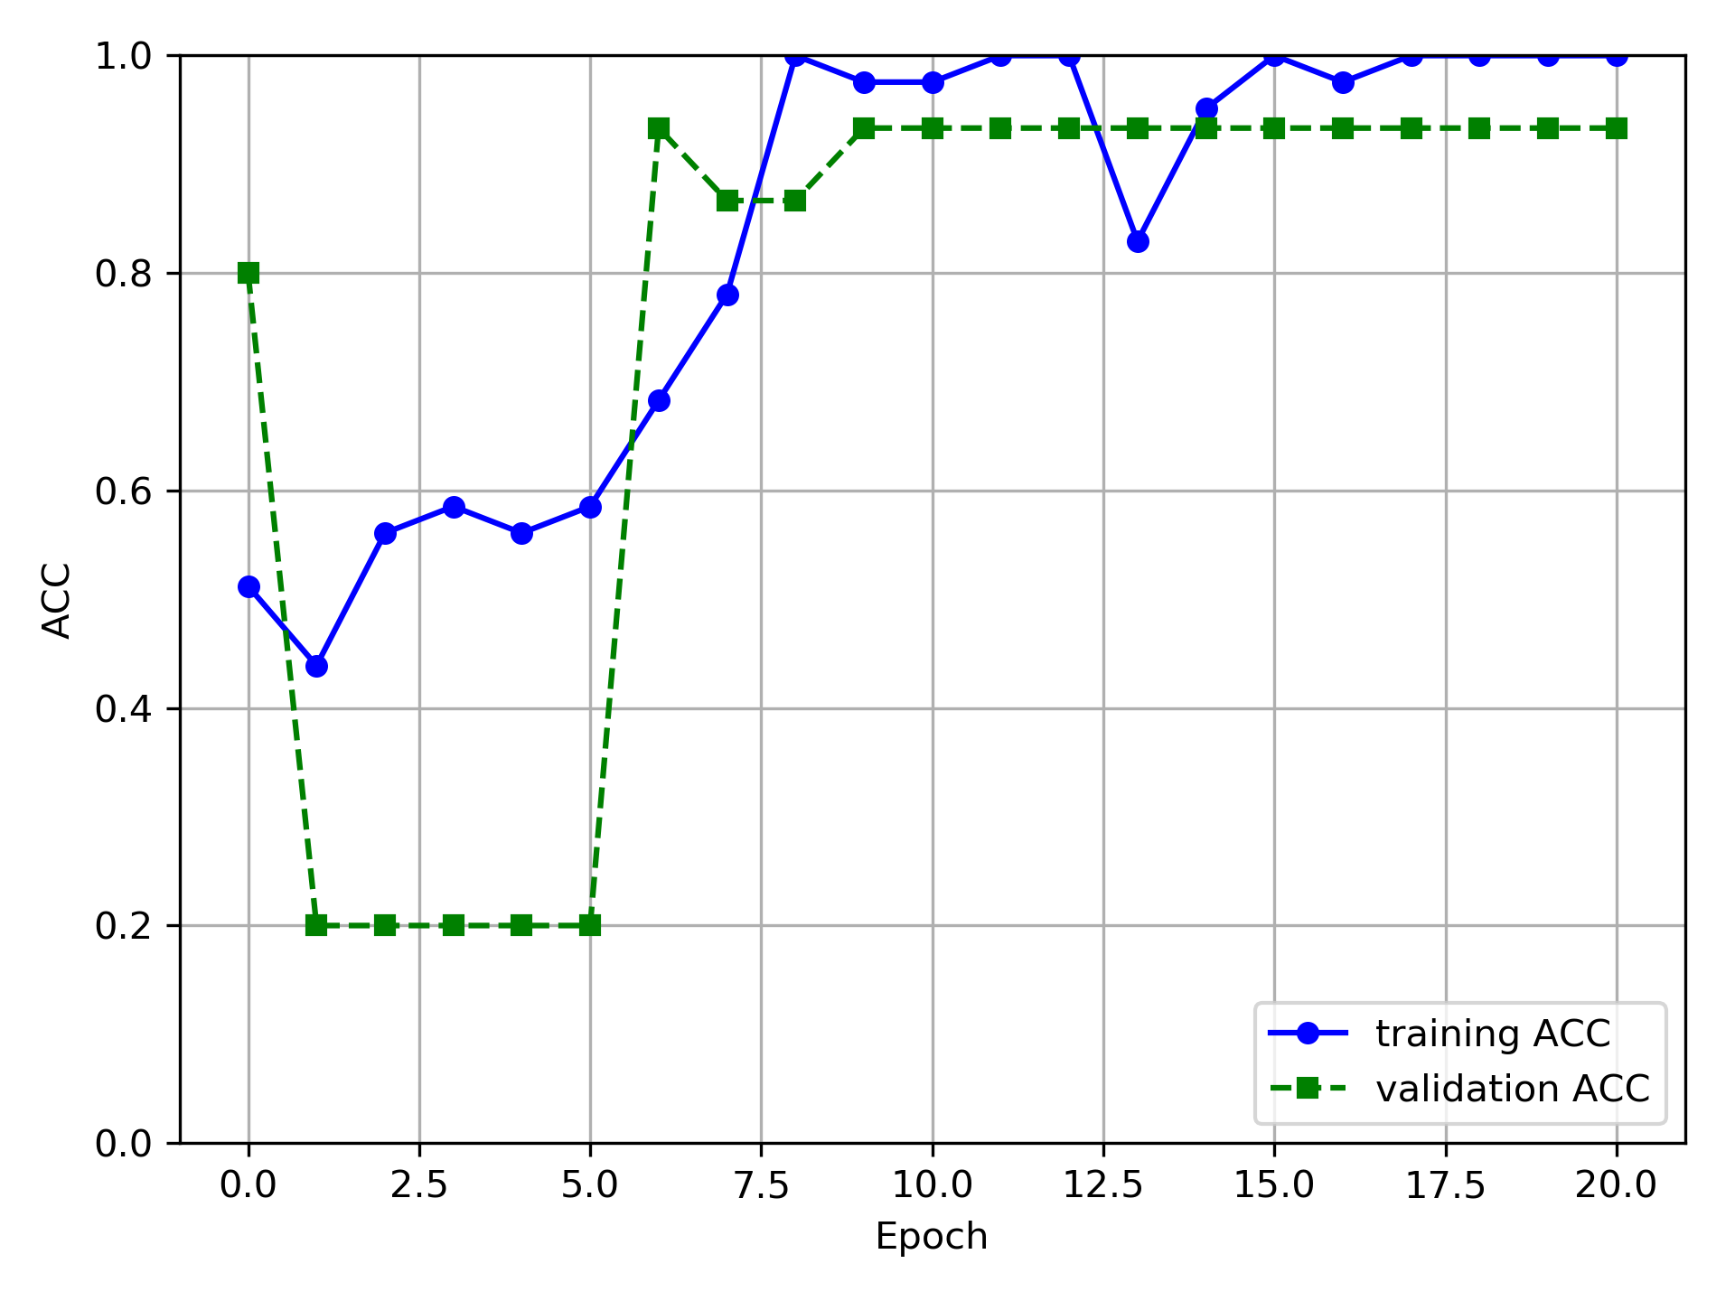
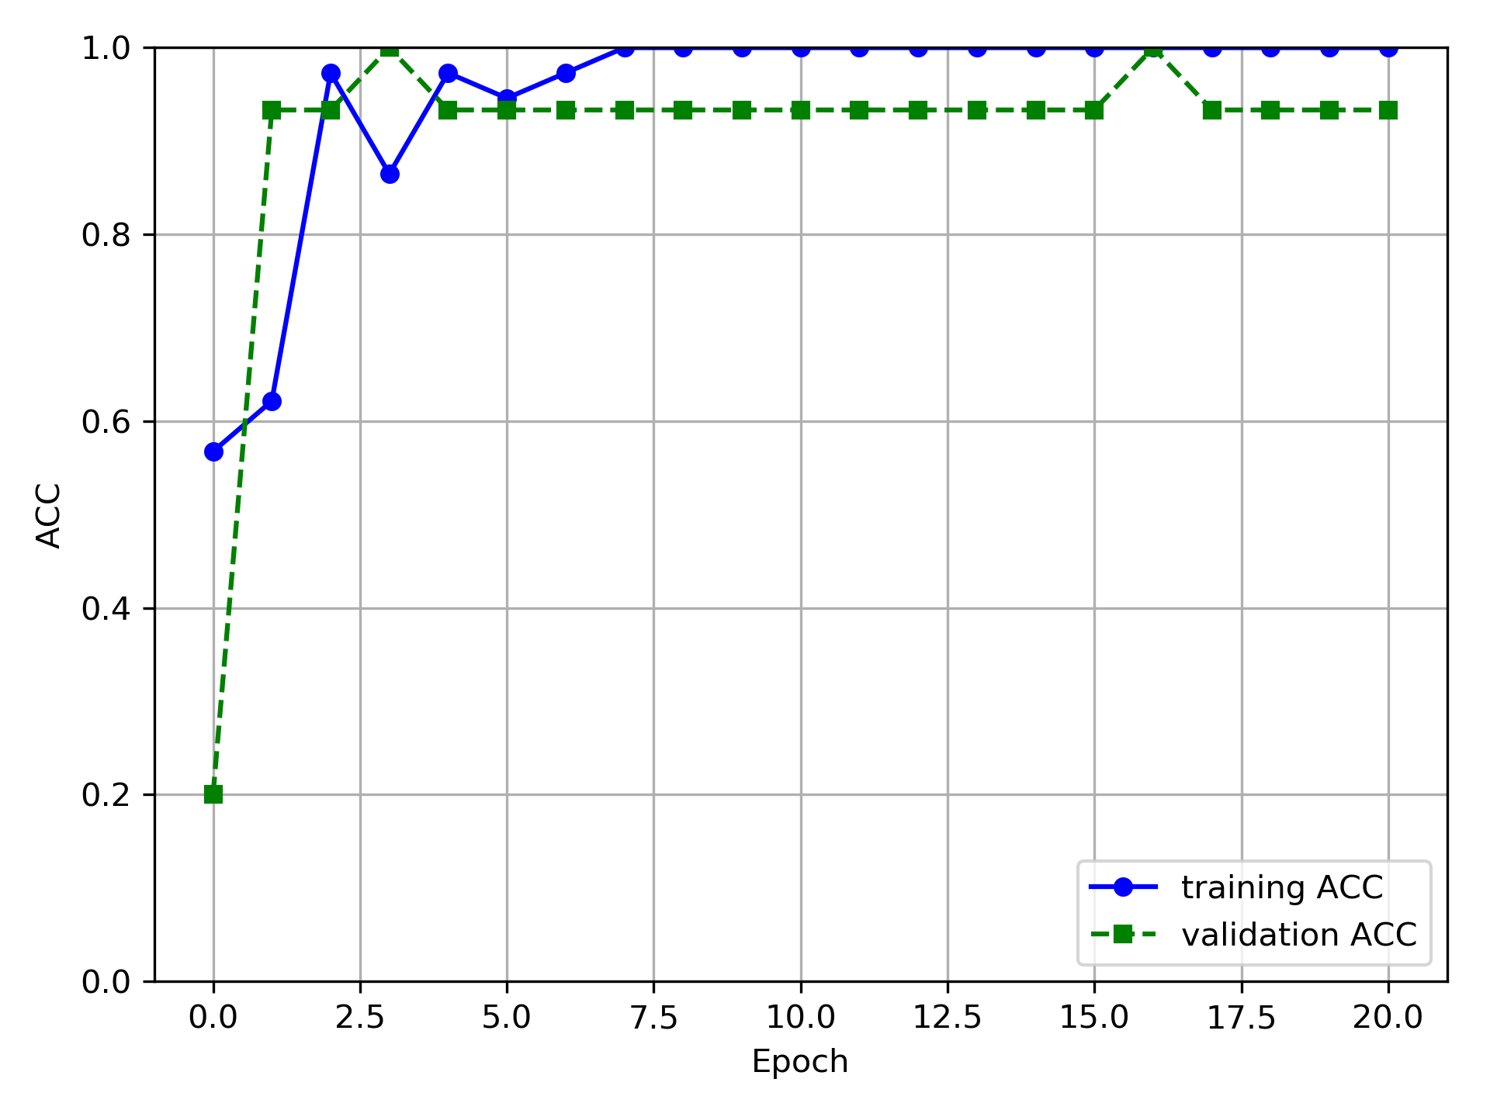
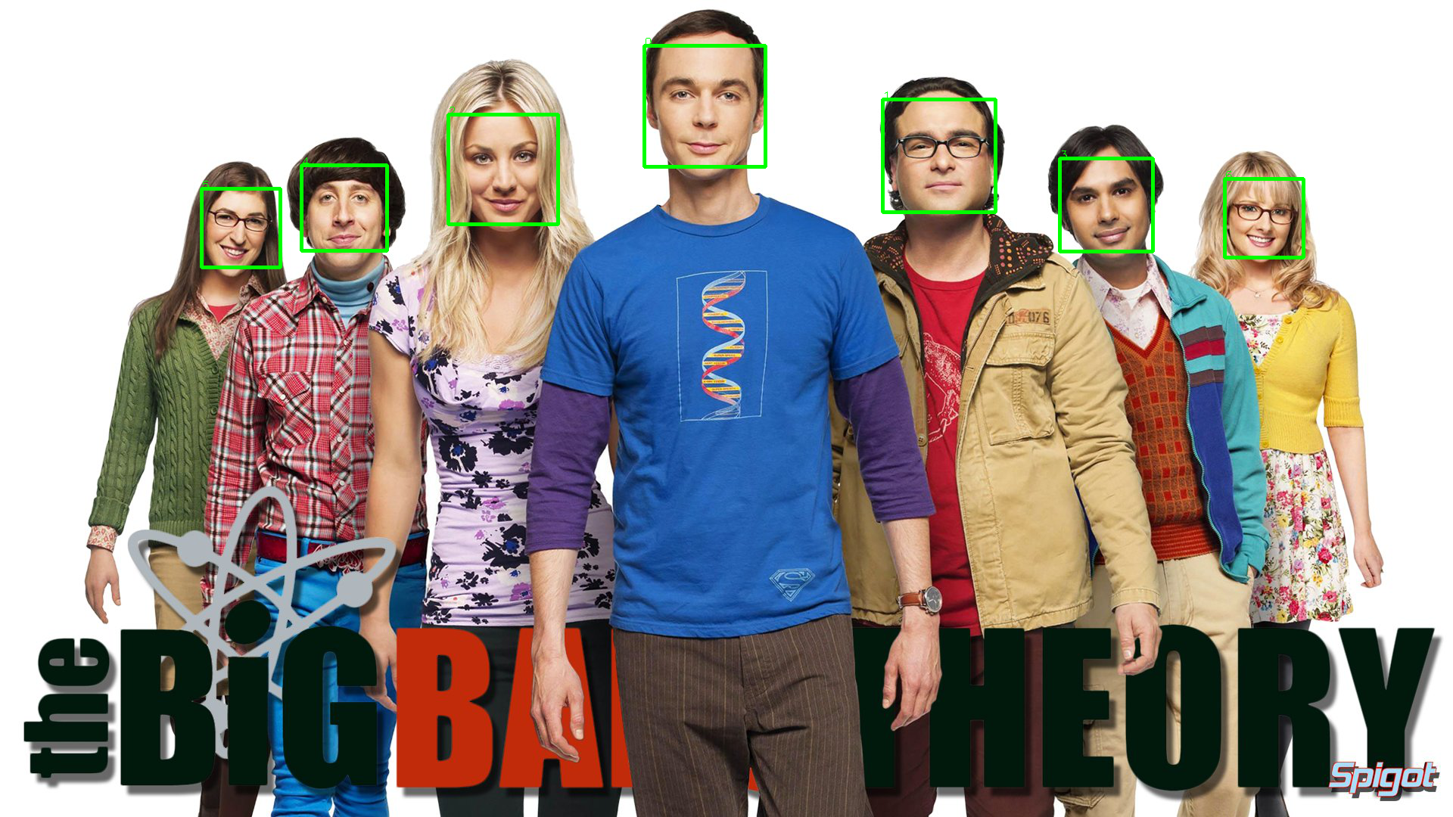




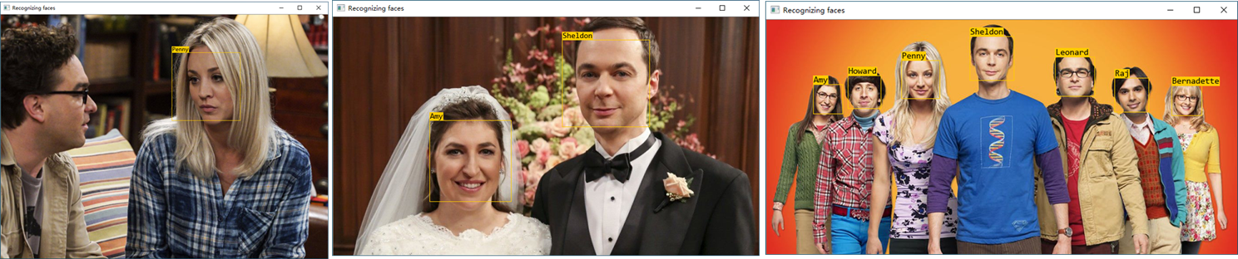



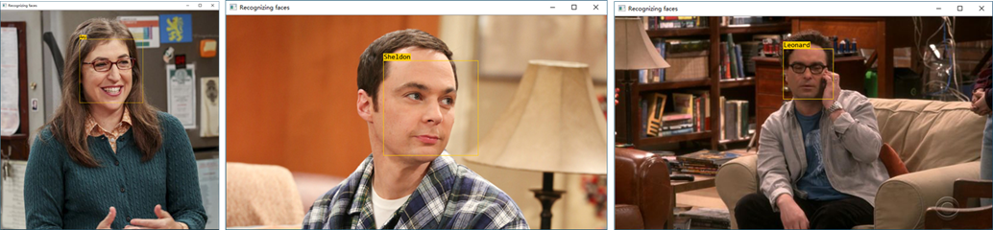
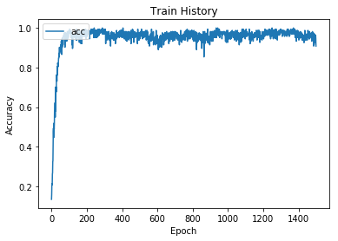
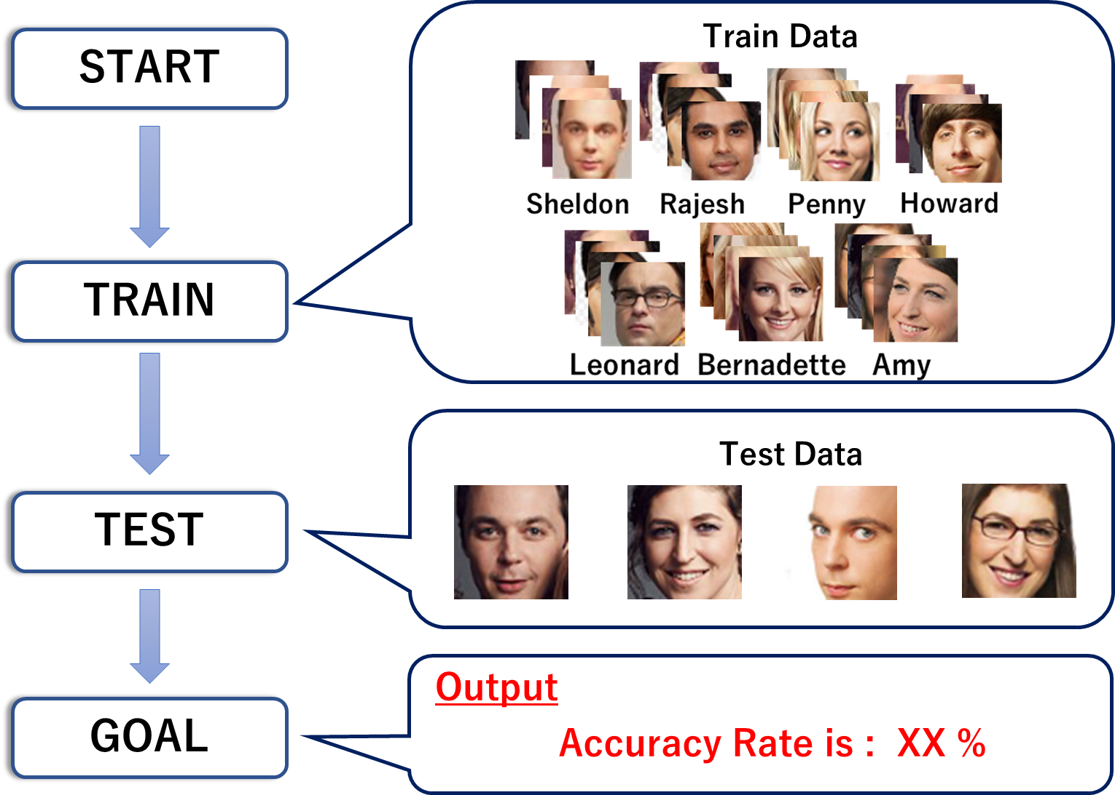
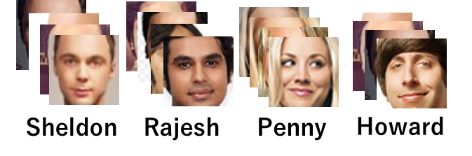
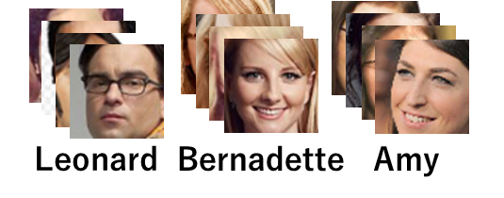
Human Facial Recognition
for Individual Identification
Tsung Da Kuo, Yu Miyashita, Xiaodong Nian
Introduction
Simulation & Results
We detect and recognize faces from the input images and show predicted labels and bounding box on the image as output. We carry out computational works by following the steps described below:
1. Facial detection
2. Facial recognition
3. Show the bounding box on the image
4. Show the labels on the image
We implement the individual identification by combining face detection and recognition method. We create a model for each face identification and used the combined result to recognize:
Face Detection
We use the CNN(Convolutional Neural Networks) structure to train the model with approximate 5700 images from LFW dataset to obtain a better result in detecting faces. Furthermore, we also successfully crop the image from our own dataset just to the face and draw the bounding box just to the face as well.
Training results
Face Detection Program
Cropped Image
Face Recognition
We aim to perform facial recognition by using Keras⁽¹⁾ computation. Approximately 200 images for training and 70 images for testing are prepared beforehand. The details of the data are as follows:
Number of individuals : 7
Train data : 192
Test data : 70
Epoch : 10, 100, 300, 1500
Output Images
Summary
In this project, we demonstrate that combining facial detection algorithm and recognition model into a complete program that is capable to label the faces and their names on the input images. Our simulation results demonstrate the program definitely shows a certain degree of intelligence to detect and recognize human faces after trained. The face detection algorithm can correctly detect most faces facing the camera in the image and CNN models are around 90% accurate to identify the faces.
Learning result
Test Result
Epoch | Accuracy rate [%]
10 | 42.8
100 | 71.4
300 | 72.8
1500 | 75.7
Facial Recognition Program
References
Dataset
1."Keras Documentation“ URL : https://keras.io/
2."Semi-supervised Learning with Constraints for Person Identification in Multimedia Data”, University of Toronto. URL:https://cvhci.anthropomatik.kit.edu/~baeuml/publications/semi-supervised-learning-with-constraints-for-person-identification-in-multimedia-data/
Number of individuals : 7
Train data : 25/person
Test data : 3/person
Epoch : 40

